Slide 1
SIT313 - Developing Client Server Web Application
Developing Client-Server Web Applications
Name: Sameera Dinusha Priyananda
SID:2151 215158268
Project 01

Slide 2
What did I implemented
Game interface - (2 days)
Game logo – (2 hours)
Screen Rotation – (2 – 3 days)
6O% of game functions done – (5 – 7 days)
Game testing – some errors fixed – ( 3 -4 days)

Slide 3
Problems and what didn’t work
Plugins problems for android planforms
Debug Errors
Runtime Errors

Slide 4
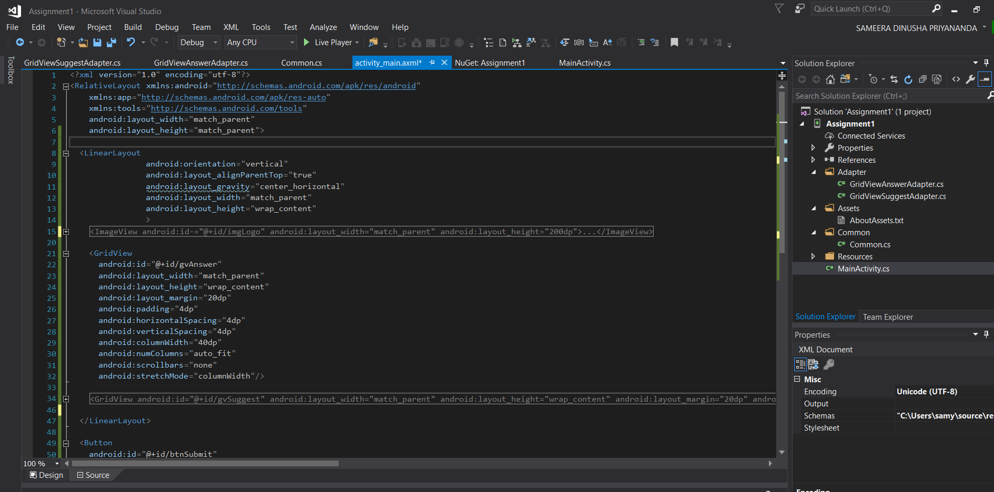
Screenshots of app code

Slide 5
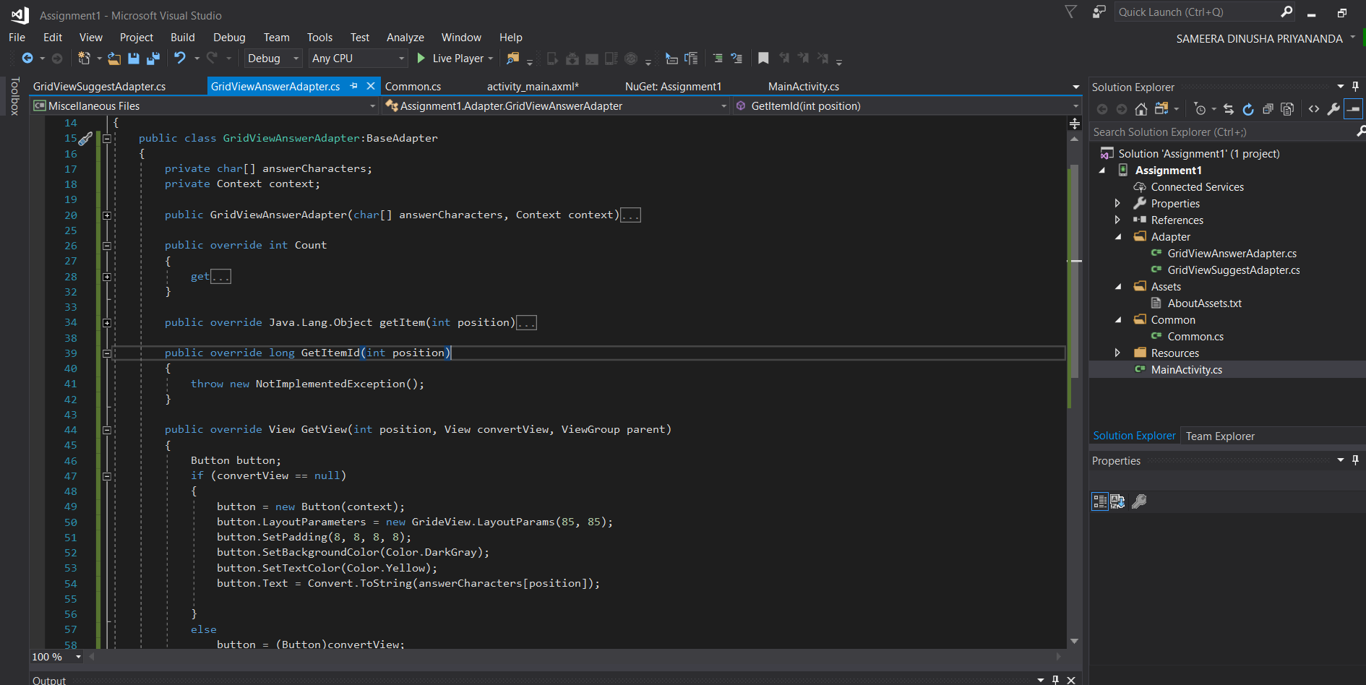
Screenshots of app code

Slide 6
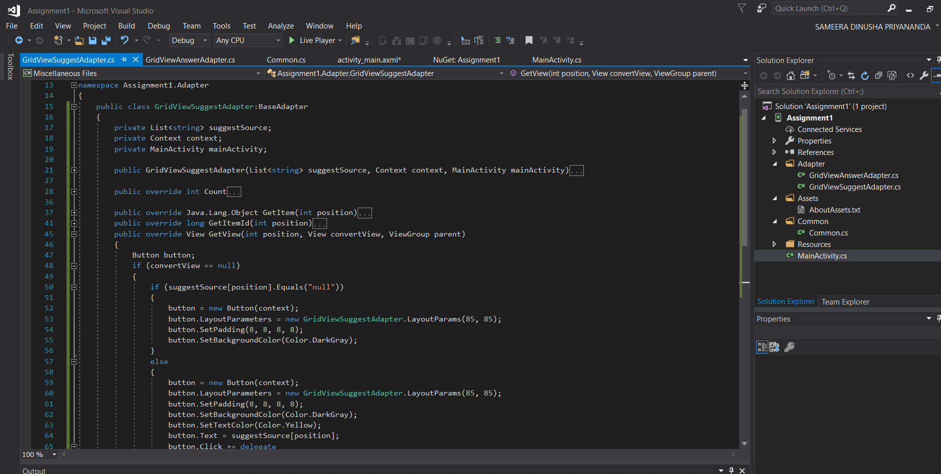
Screenshots of app code

Slide 7
Plans for next few days
Implement the game play music
Fixing the errors
Run through different android devices
Final test run and submit the project

Slide 8
GitHub Link
Project Link: https://github.com/samara92/SIT313_Project1
Project Proposal Video Link: https://github.com/samara92/SIT313_Project1/blob/master/Project%20proposal%20video.mp4
Project Progress Video Link: https://github.com/samara92/SIT313_Project1/blob/master/project_progress.mp4

Slide 9
Thank You

